Slide 1
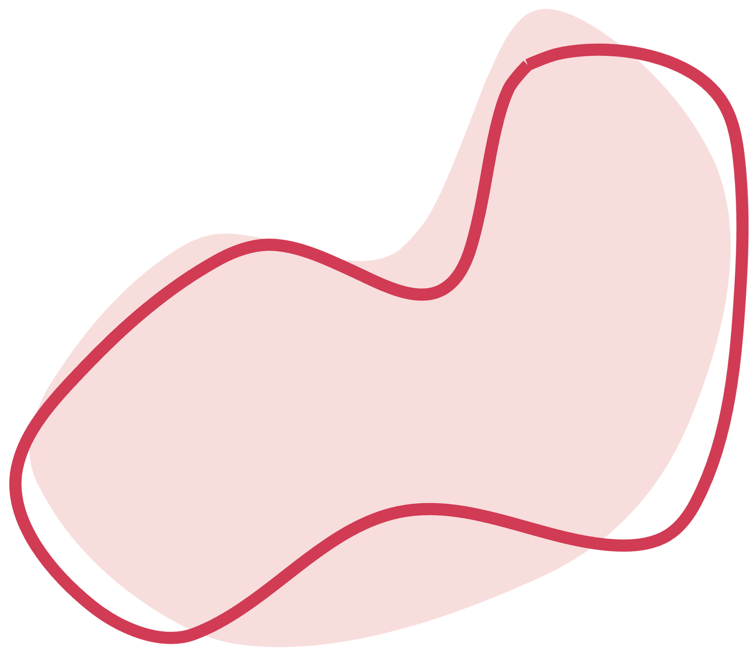



Case Study
Thoracoabdominal aortic aneurysm repair
Shadé Paul
DUT - BHSC Student
CMJAH

Slide 2

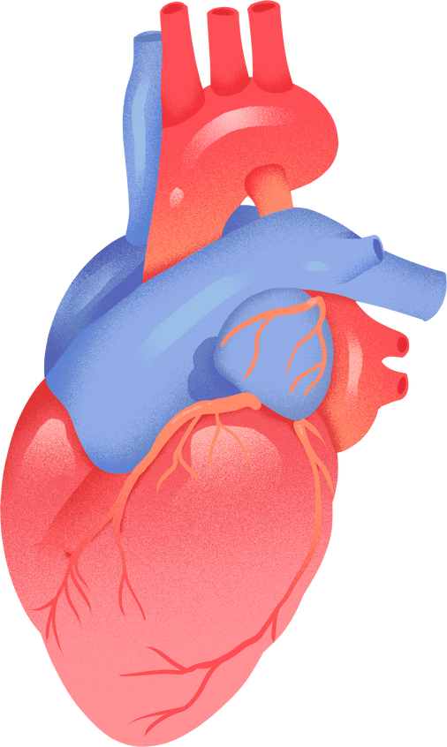
Agenda
01
02
03
Anatomy and Patholgy
Crawford’s Classification
The Patient
04
05
06
Temperature Management & Approach
Organ Perfusion
Cannulation
07
08
09
Contrast with literature
Methods of Correction
References

Slide 3



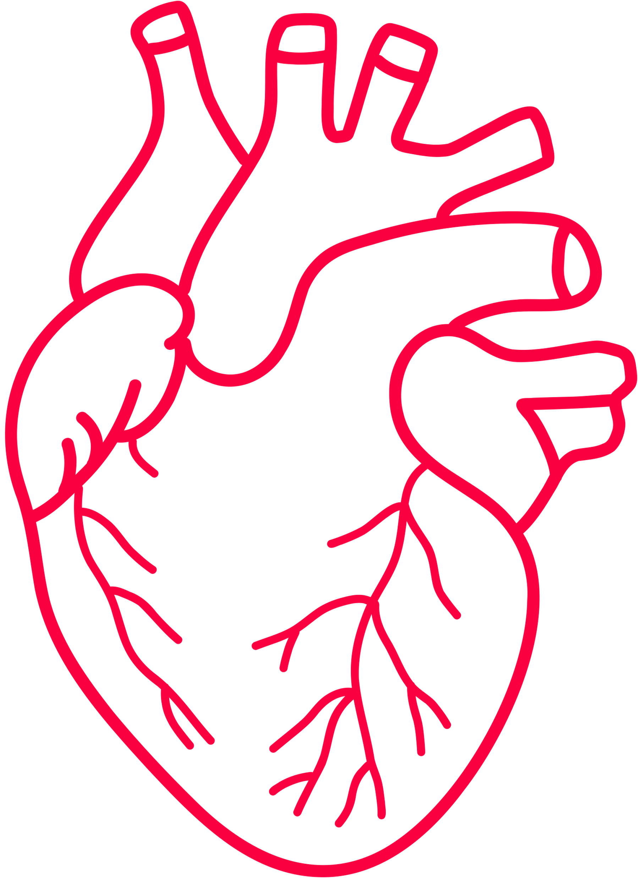
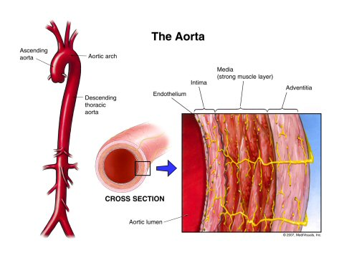
Anatomy and Pathology
Thoracoabdominal aorta - origin of left subclavian artery to aortoiliac bifurication.
Medial layer - primary elastin and collagen, to provide structural integerity and elasticity.
Degeneration of these proteins - weakening of the aortic wall, predisposing to aneurysmal dilation.
Secondary to genetic disorders - Marfan syndrome, Ehlers-Danlos syndrome, Loeys-Dietz syndrome and Turner’s syndorme.
Other etiologies - Polycystic kidney disease, syphilitic arteritis, traumatic injury and chronic aortic dissection.
Atherosclerosis and associated risk factors: smoking, hypertension, obesity, hyperlipidemia and COPD.
Lower incidents of concomitant cornoary artery disesase.

Slide 4

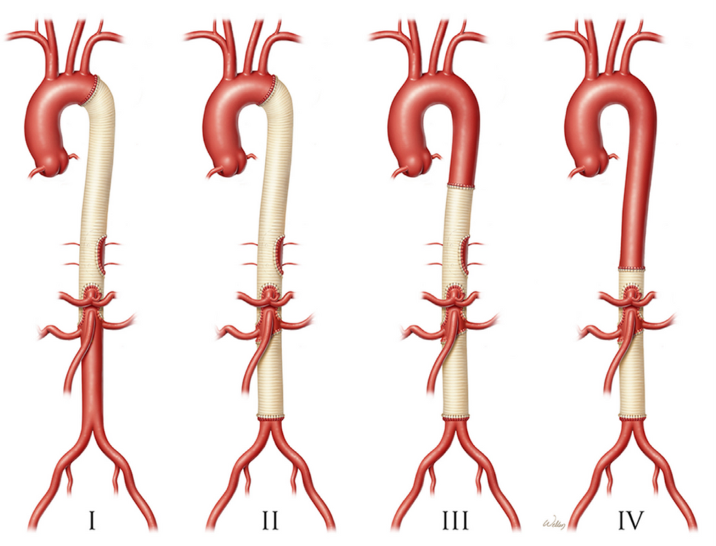
Crawford Extent II thoracoabdominal aortic aneurysm
Complex vascular pathology - progressive dilation of the descending thoracic aorta extending into the abdominal aorta.
Crawford’s classification system:
Type I - ·Descending thoracic aorta to suprarenal abdominal aorta
Type II - From subclavian origin to aortoiliac bifurcation
Type III - Distal thoracic aorta to aortoiliac bifurcation
Type IV - Abdominal aorta below the diaphragm
Type V - Distal thoracic aorta including celiac and superior mesenteric origins but excluding renal arteries

Slide 5
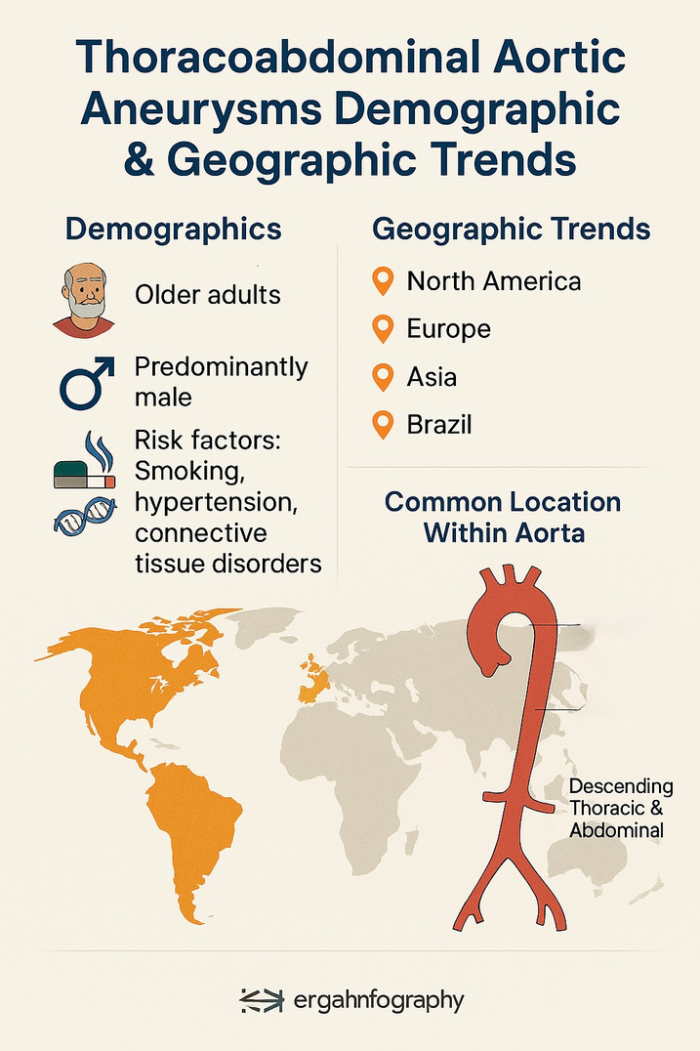

Natural progression - rupture or dissection with untreated cases demonstrating 5 year survival of only 10-20%.
Advanced age and female sex significantly increases rupture risk
Aneurysm size: exceeding 6cm has a rupture risk of 7%, and those greater then 7cm are 43%.
Predominantly affect older adult men
Global incidence - 5.3 per 100 000/year and prevalence at 0.16%.
North America - 7.3 per 100 000/year and prevalence of 0.12%
Europe - 4.8 per 100 000/year and prevalence of 0.25%
Asia - prevalence around 0.16%
South America - 0.33 per 100 000/year and prevalence of 0.012%
Most prevalent in high-income countries and significant atherosclerotic disease burden

Slide 6


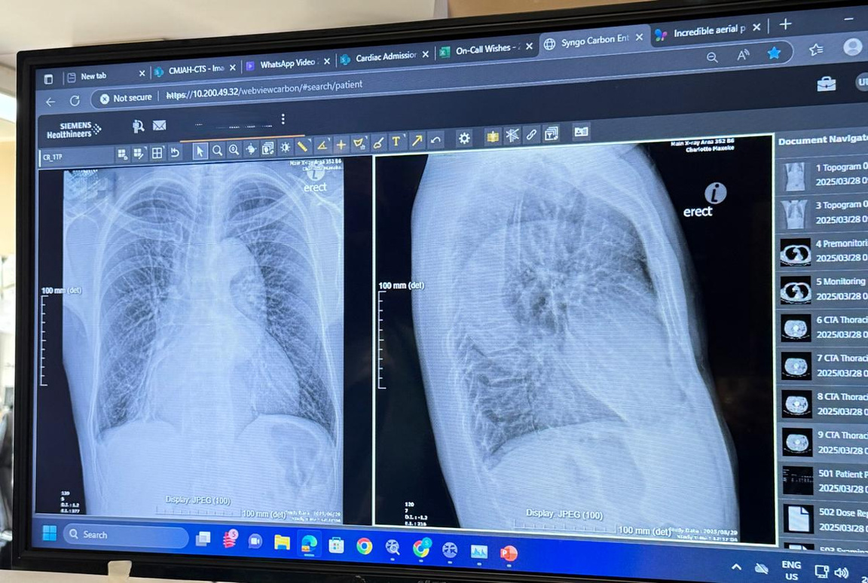
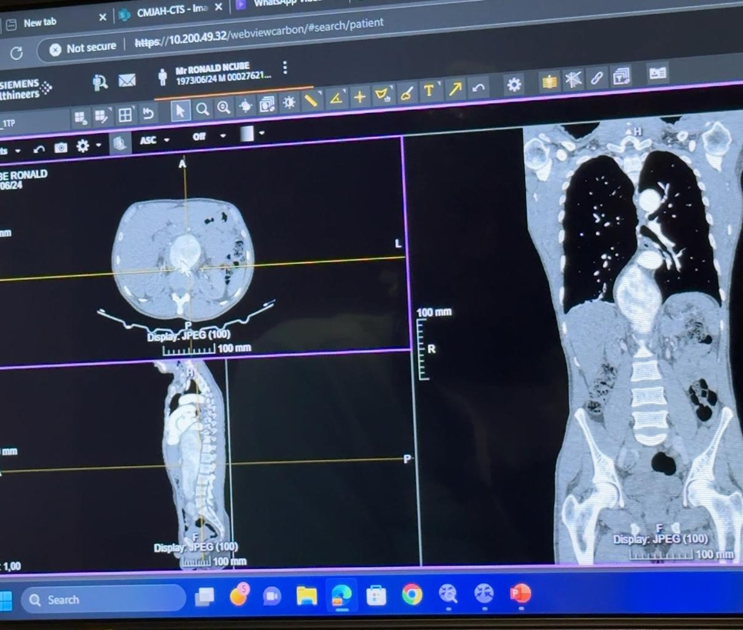
The Patient
Symptomatic, massive Extent II TAAA measuring around 9.2cm across, a sequela of a chronic Stanford type B dissection.
52 year old South African black male.
Highly tortuous and heavily calcified aorta, with the true lumen severely compromised, high risk for malperfusion.
Involvement of all visceral and renal arteries (intercostals from T6 to L2) - spinal cord ischemia.

Slide 7


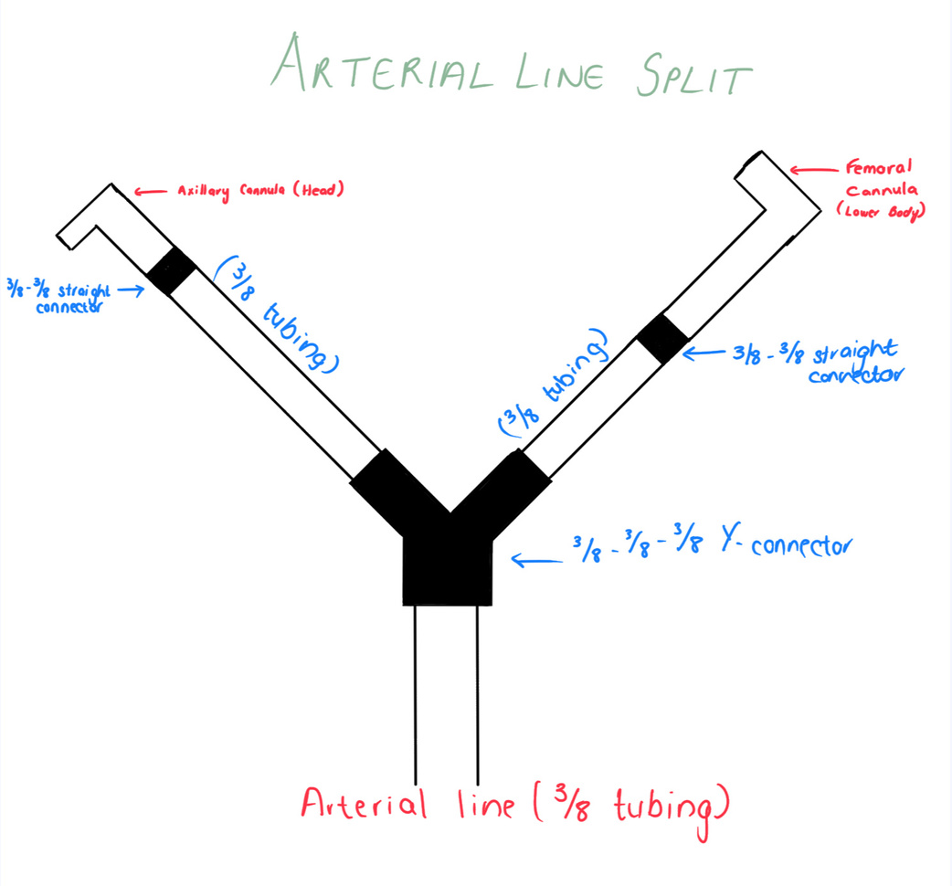
Cannulation
A 20Fr cannula in the right axillary artery for dedicated antegrade cerebral perfusion.
A 19Fr cannula in the femoral artery for lower body perfusion.
The arterial line was split, allowing us to independently control flow to the upper and lower body, a technique supported for managing malperfusion.
21Fr cannula placed in the femoral vein for venous drainage.

Slide 8
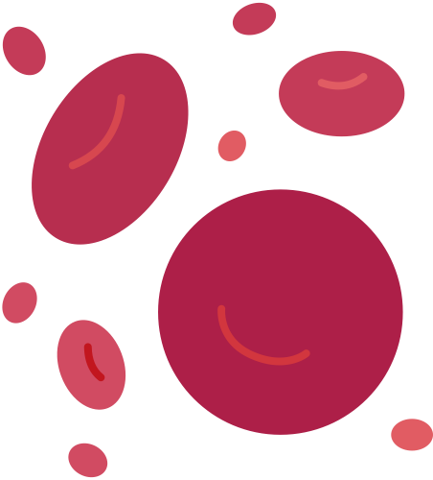


Temperature Management & Approach
Phase 2: After applying the proximal cross-clamp, we unclamped the femoral line, bringing flows up to 100% and perfusing the entire body. At no point was the patient in circulatory arrest.
Phase 1: We began flowing only to the head via the axillary cannula at about 60% of full flow,
Deep hypothermia (often 18-20°C) required for DHCA
Patient was cooled only to 30°C, a level of moderate hypothermia.

Slide 9

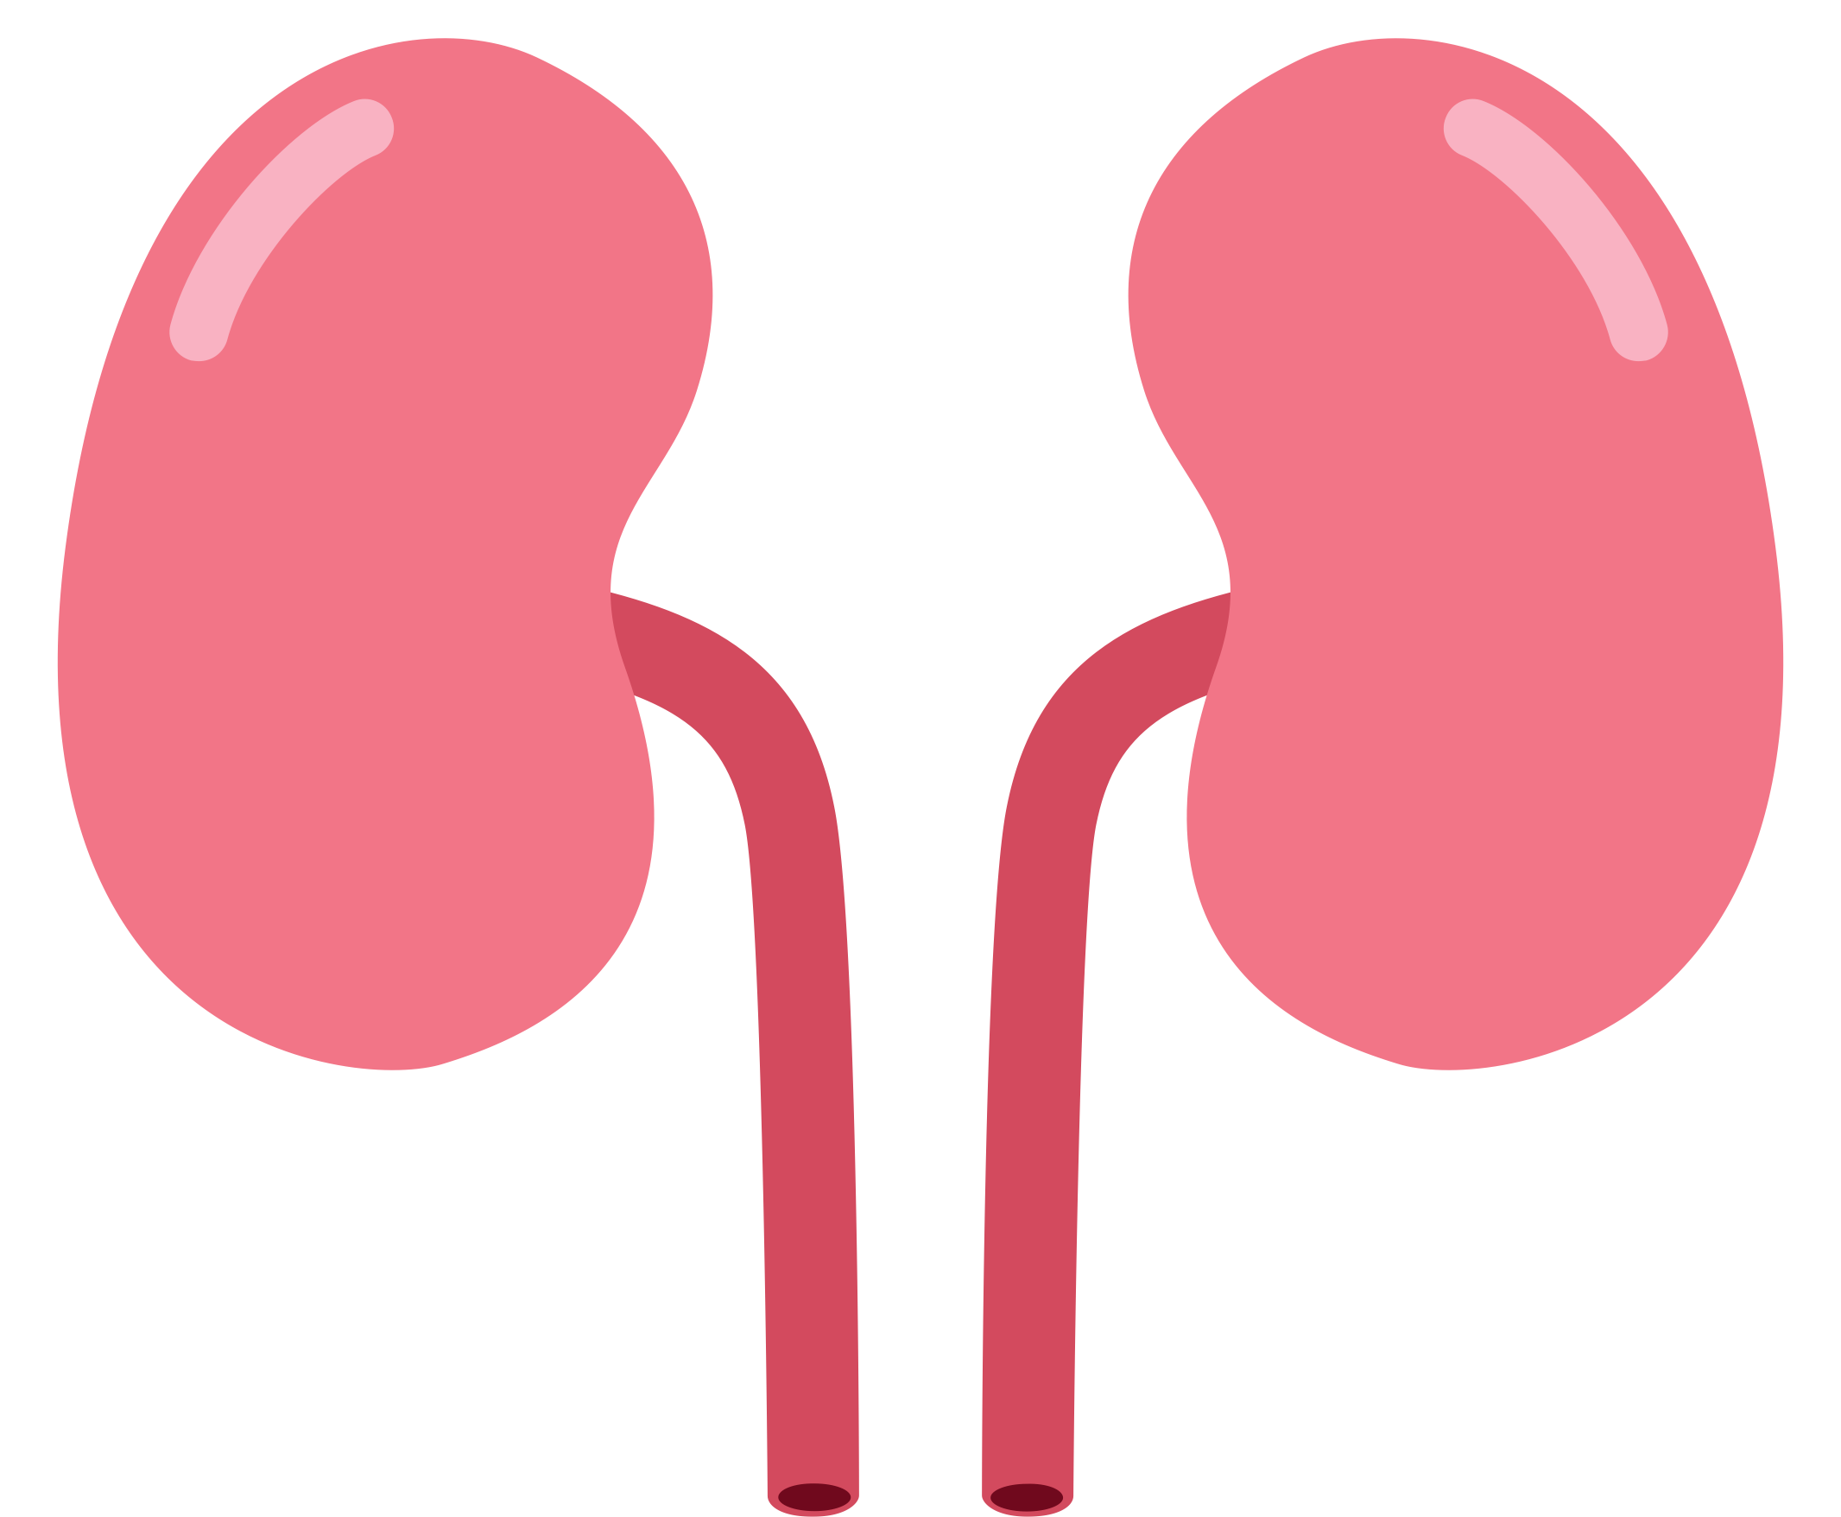
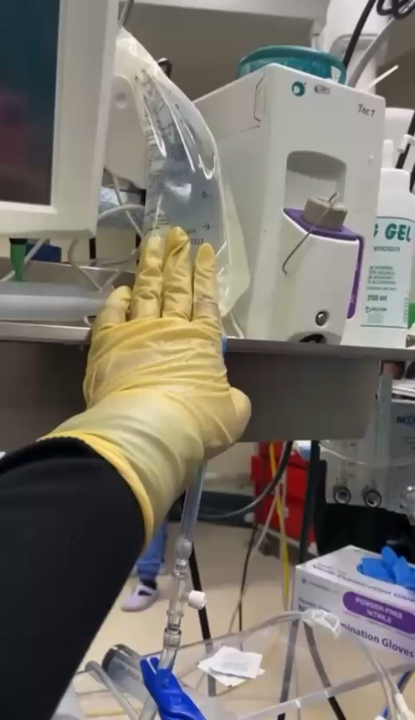
Organ Perfusion
Simple repair - simple cold crystalloid perfusion (e.g., 4°C Lactated Ringer's) or passive shunt perfusion for organ protection.
Mesenteric arteries MPS cold blood oxygen and substrates.
Renal arteries cold crystalloid solution (Ringers lactate with 20g of Mannitol) every 3-5 minutes Cardioplegia system roller pump.
20g of Mannitol targeted free-radical scavenging & osmotic diuresis.
Hemoconcentrator fluid load and haemodilution from the renal perfusion.
Sodium Bicarbonate refractory metabolic acidosis
Fresh Frozen plasma coagulopathy typically follows complex aortic repairs.

Slide 10

Contrasting with the Literature
Feature | Conventional Approach (Kouchoukos 2012) | Our Tailored Strategy
Core Technique | Deep Hypothermic Circulatory Arrest (DHCA) | Moderate Hypothermia + Continuous Perfusion
Temperature | ~18°C | 30°C
Circulatory State | Total Arrest | Continuous, Phased Flow
Organ Protection | Global hypothermia, simple crystalloid | Segmented, Blood-Based & Crystalloid Renal Solution

Slide 11

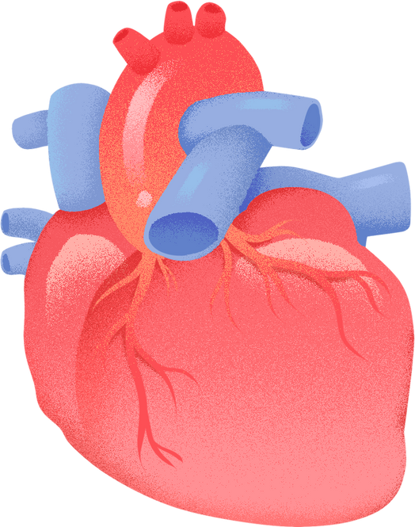
Methods of Correction
Open surgical repair - damaged section of the aorta is removed and replaced with a synthetic tube graft, which is then sewn into place. Minimize the risk of complications like spinal cord injury and organ failure, several techniques are used:
Cerebrospinal Fluid Drainage
Distal Aortic Perfusion
Visceral & Renal Perfusion
Intercostal Artery Reattachment
Endovascular Repair - Catheter inserted through femoral artery and stent graft is depolyed within the weakened aorta. Different types:
Thoracic Endovascular Aortic Repair
Fenestrated-Branched Endovascular Aortic Repair
Hybrid Repair - combines both open and endovaculartechniques for high risk patients.
Non-surgical Mnagement - for small asymptomatic aneuryms, regular imaging and blood pressure control.

Slide 12
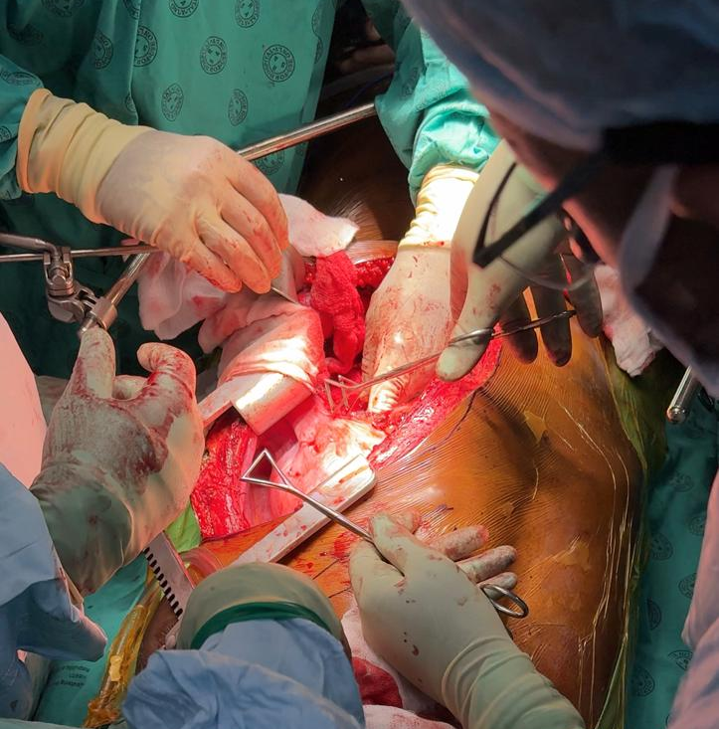
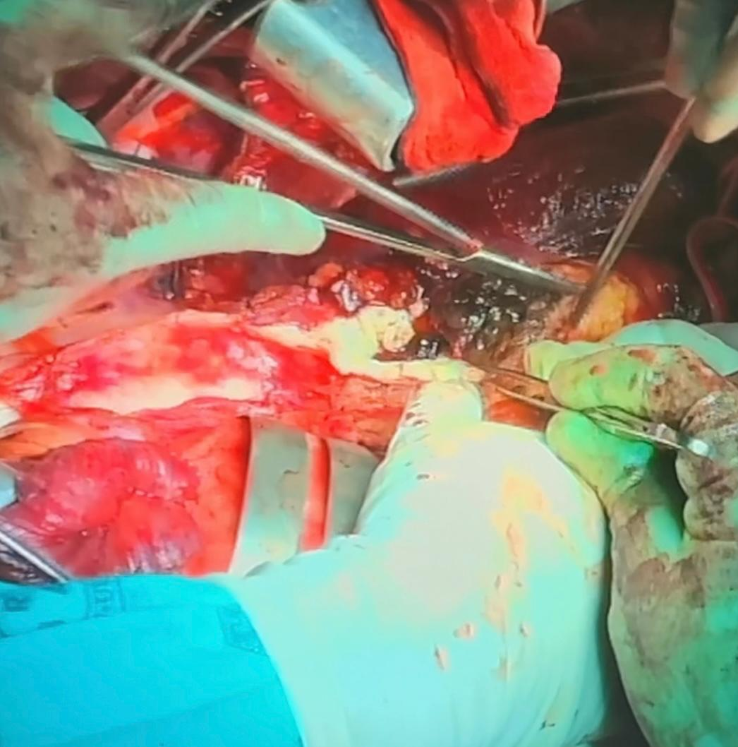
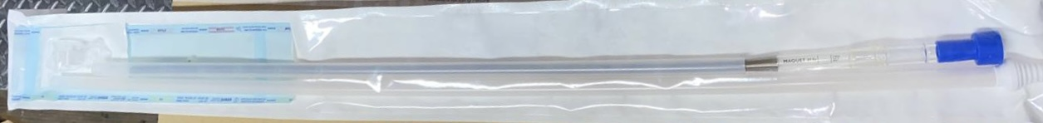
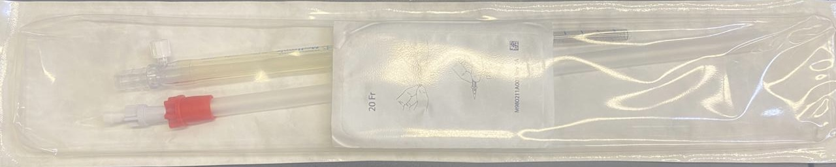
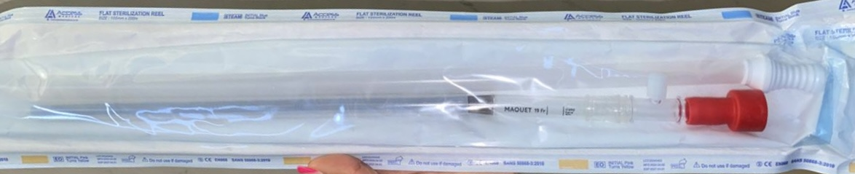

Slide 13
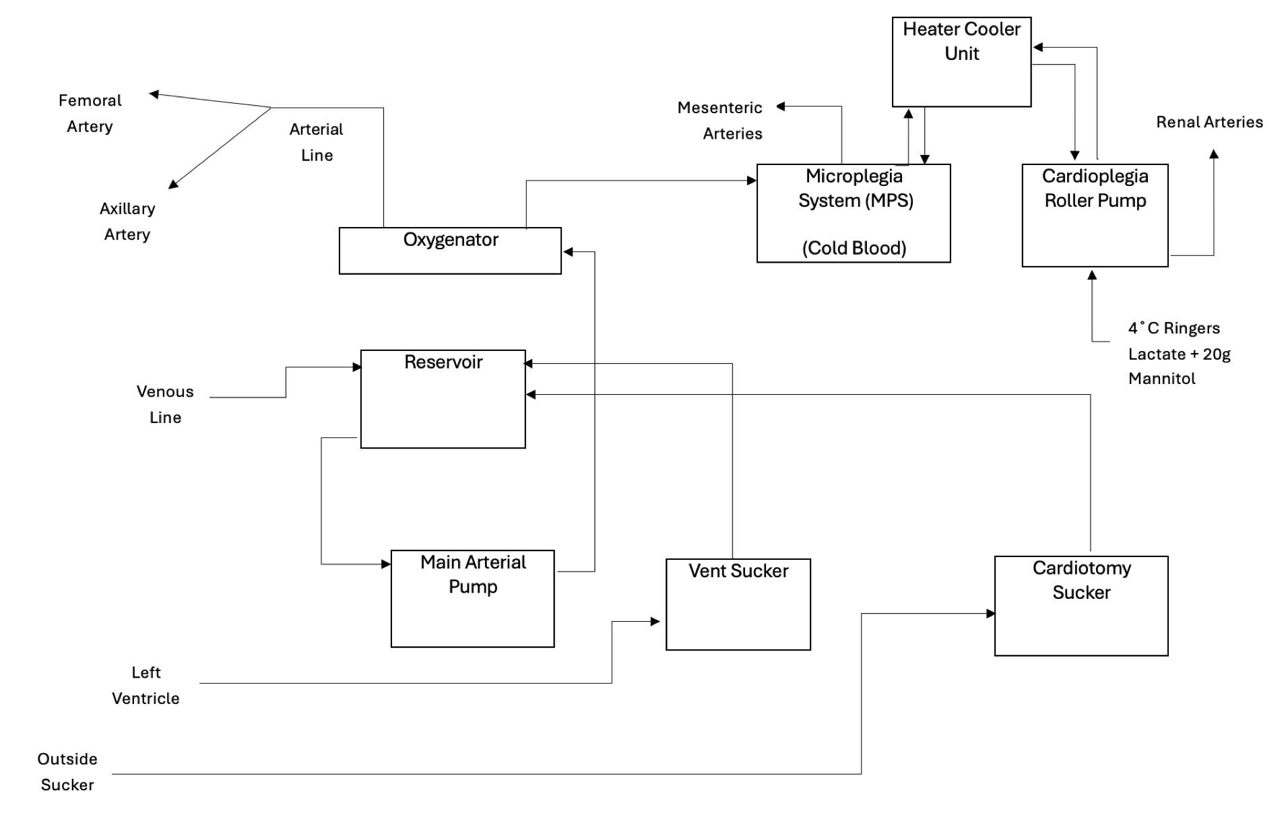
Diagram of the Extracorporeal Circuit

Slide 14


References
Geol, N, Jain, D, Savlania, A & Bansal, A. 2019. Thoracoabdominal Aortic Aneurysm Repair: What Should the Anaesthetist Know? Turkish Journal of Anesthesia and Reanimation. 47(1):1–11. doi.org/https://doi.org/10.5152/tjar.2018.39129.
Gouveia e Melo, R, Silva Duarte, G, Lopes, A, Alves, M, Caldeira, D, Fernandes e Fernandes, R & Mendes Pedro, L. 2022. Incidence and Prevalence of Thoracic Aortic Aneurysms: A Systematic Review and Meta-analysis of Population-Based Studies. Seminars in Thoracic and Cardiovascular Surgery. 34(1):1–16. doi.org/https://doi.org/10.1053/j.semtcvs.2021.02.029.
Kothari, R, Weldon, SA, Cuneyt Koksoy & Coselli, JS. 2021. Narrative review: open surgery for thoracoabdominal aortic aneurysm—is it still a horrible surgery? Journal of Visualized Surgery. 8:4–4. doi.org/https://doi.org/10.21037/jovs-20-113.
Kouchoukos, NT. 2012. Thoracoabdominal aortic aneurysm repair using hypothermic cardiopulmonary bypass and circulatory arrest. PubMed. (September, 1). doi.org/https://doi.org/10.3978/j.issn.2225-319x.2012.08.09.
Lopez-Marco, A, Adams, B & Oo, AY. 2022. Thoracoabdominal Aneurysms—Operative Steps for Crawford Extent II Repair. Operative Techniques in Thoracic and Cardiovascular Surgery. 27(1):39–64. doi.org/https://doi.org/10.1053/j.optechstcvs.2021.12.005.
Ouzounian, M, LeMaire, SA, Weldon, S & Coselli, JS. 2018. Open Repair of Thoracoabdominal Aortic Aneurysm: Step-by-Step. Operative Techniques in Thoracic and Cardiovascular Surgery. 23(1):2–20. doi.org/https://doi.org/10.1053/j.optechstcvs.2018.07.002.
Rosenblum, JM & Chen, EP. 2019. Thoracoabdominal aortic aneurysm repair: open, endovascular, or hybrid? General thoracic and cardiovascular surgery. 67(1):175–179. doi.org/https://doi.org/10.1007/s11748-017-0820-y.

