Slide 1


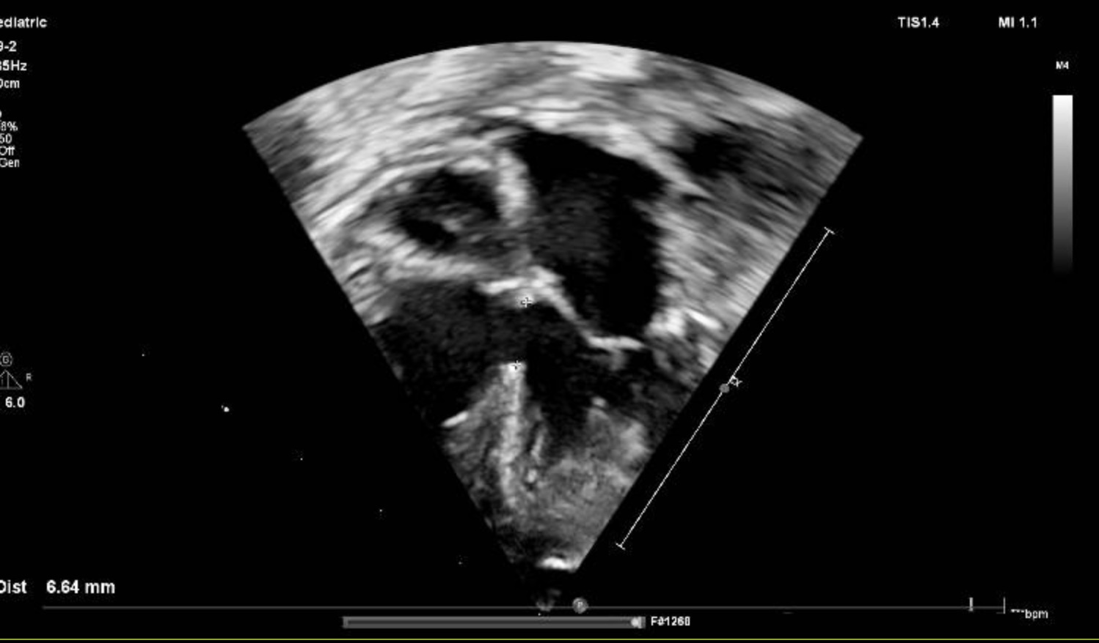
Neonatal Hypoplastic Arch + VSD
Advanced Perfusion Strategy with Brief DHCA and Extended Selective Cerebral Perfusion in a 2.4 kg Infant
Presented by:
Alden Anirudhe
BHSc Clinical Technology final year Cardiovascular Perfusion student at Groote Schuur and Red Cross War Memorial Childrens Hospital

Slide 2
Contents
  Patient profile and perfusion risk
  Cannulation and circuit setup
  Temperature management
  DHCA and selective cerebral perfusion
  Del Nido cardioplegia
  Blood conservation and ultrafiltration
  Outcomes and literature comparison

Slide 3
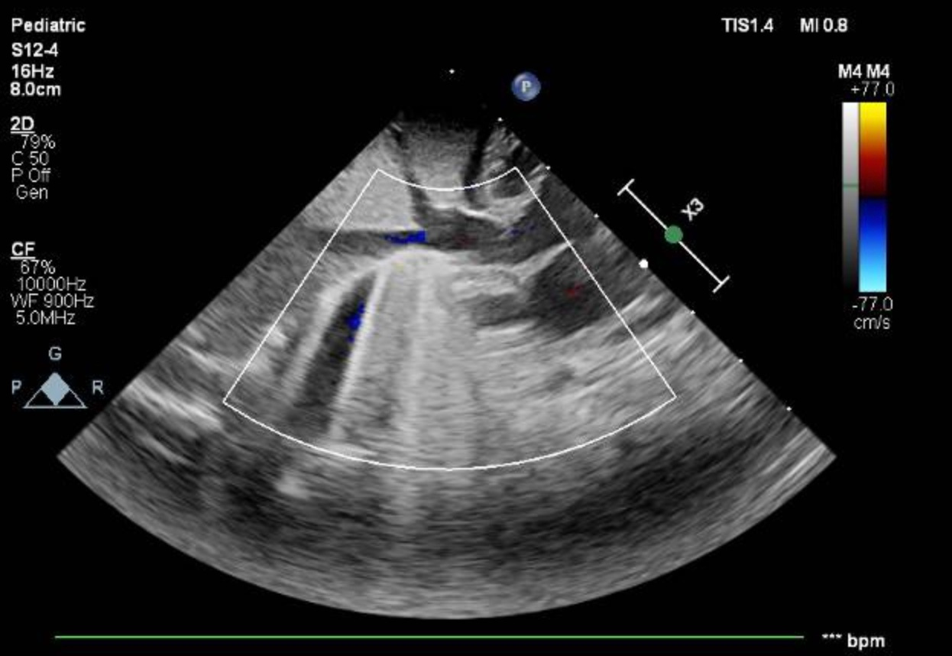
Patient Demographics
  13-day-old neonate
  Weight: 2.4 kg
  Height: 47 cm
  Diagnosis: hypoplastic aortic arch with VSD
  Weight under 2.5 kg is a recognized high-risk category in neonatal arch-related surgery

Slide 4
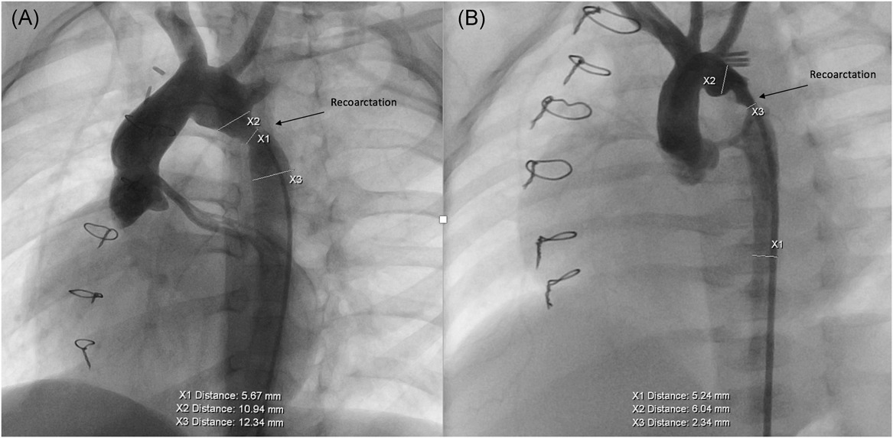
High Risk Profile
Neonates under 2.5 kg have less physiologic reserve and a much smaller circulating blood volume
In low-weight neonates, prime volume and transfusion exposure become major perfusion concerns
Arch obstruction cases in patients ≤2.5 kg are associated with a 10.9% increase in mortality risk VS 4.8% for patients above 2.5kg (Kalfa et al., 2014)

Slide 5
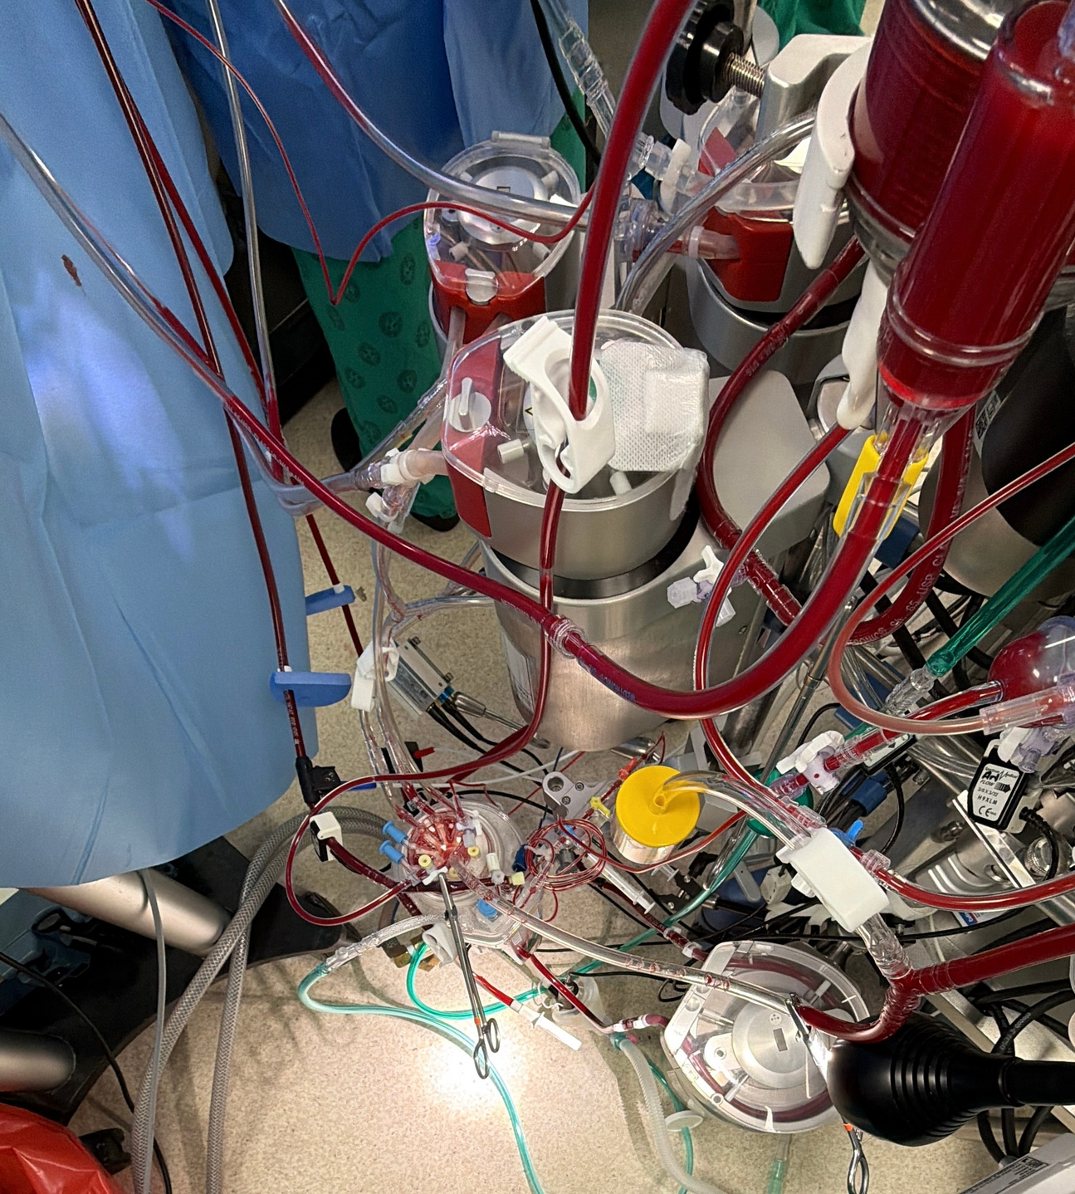
Perfusion Strategy
  Deep hypothermia to 20°C
  Brief DHCA for arch transition
  Extended selective cerebral perfusion for brain protection
  Del Nido cardioplegia for myocardial protection
  Blood prime with low-volume oxygenator
  Hemoconcentration and zero-balance ultrafiltration for blood conservation and metabolic control

Slide 6
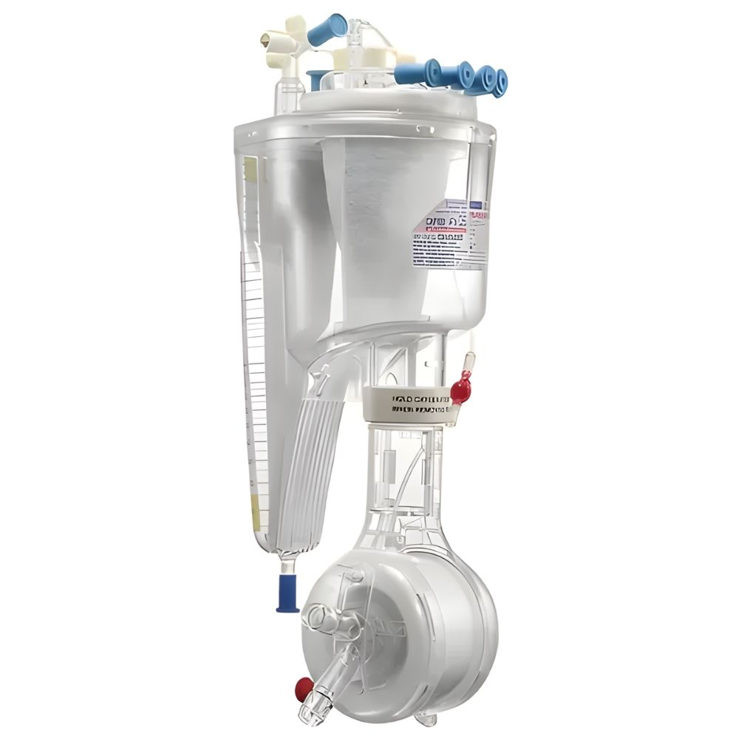
Circuit Selection & Priming Strategy
Oxygenator Selection: Terumo Capiox FX05.
Total static priming volume is only 43 mL. Minimizing circuit surface area directly attenuates the systemic inflammatory response syndrome routinely triggered by neonatal bypass loops.
Priming: 1 unit of packed red blood cells

Slide 7
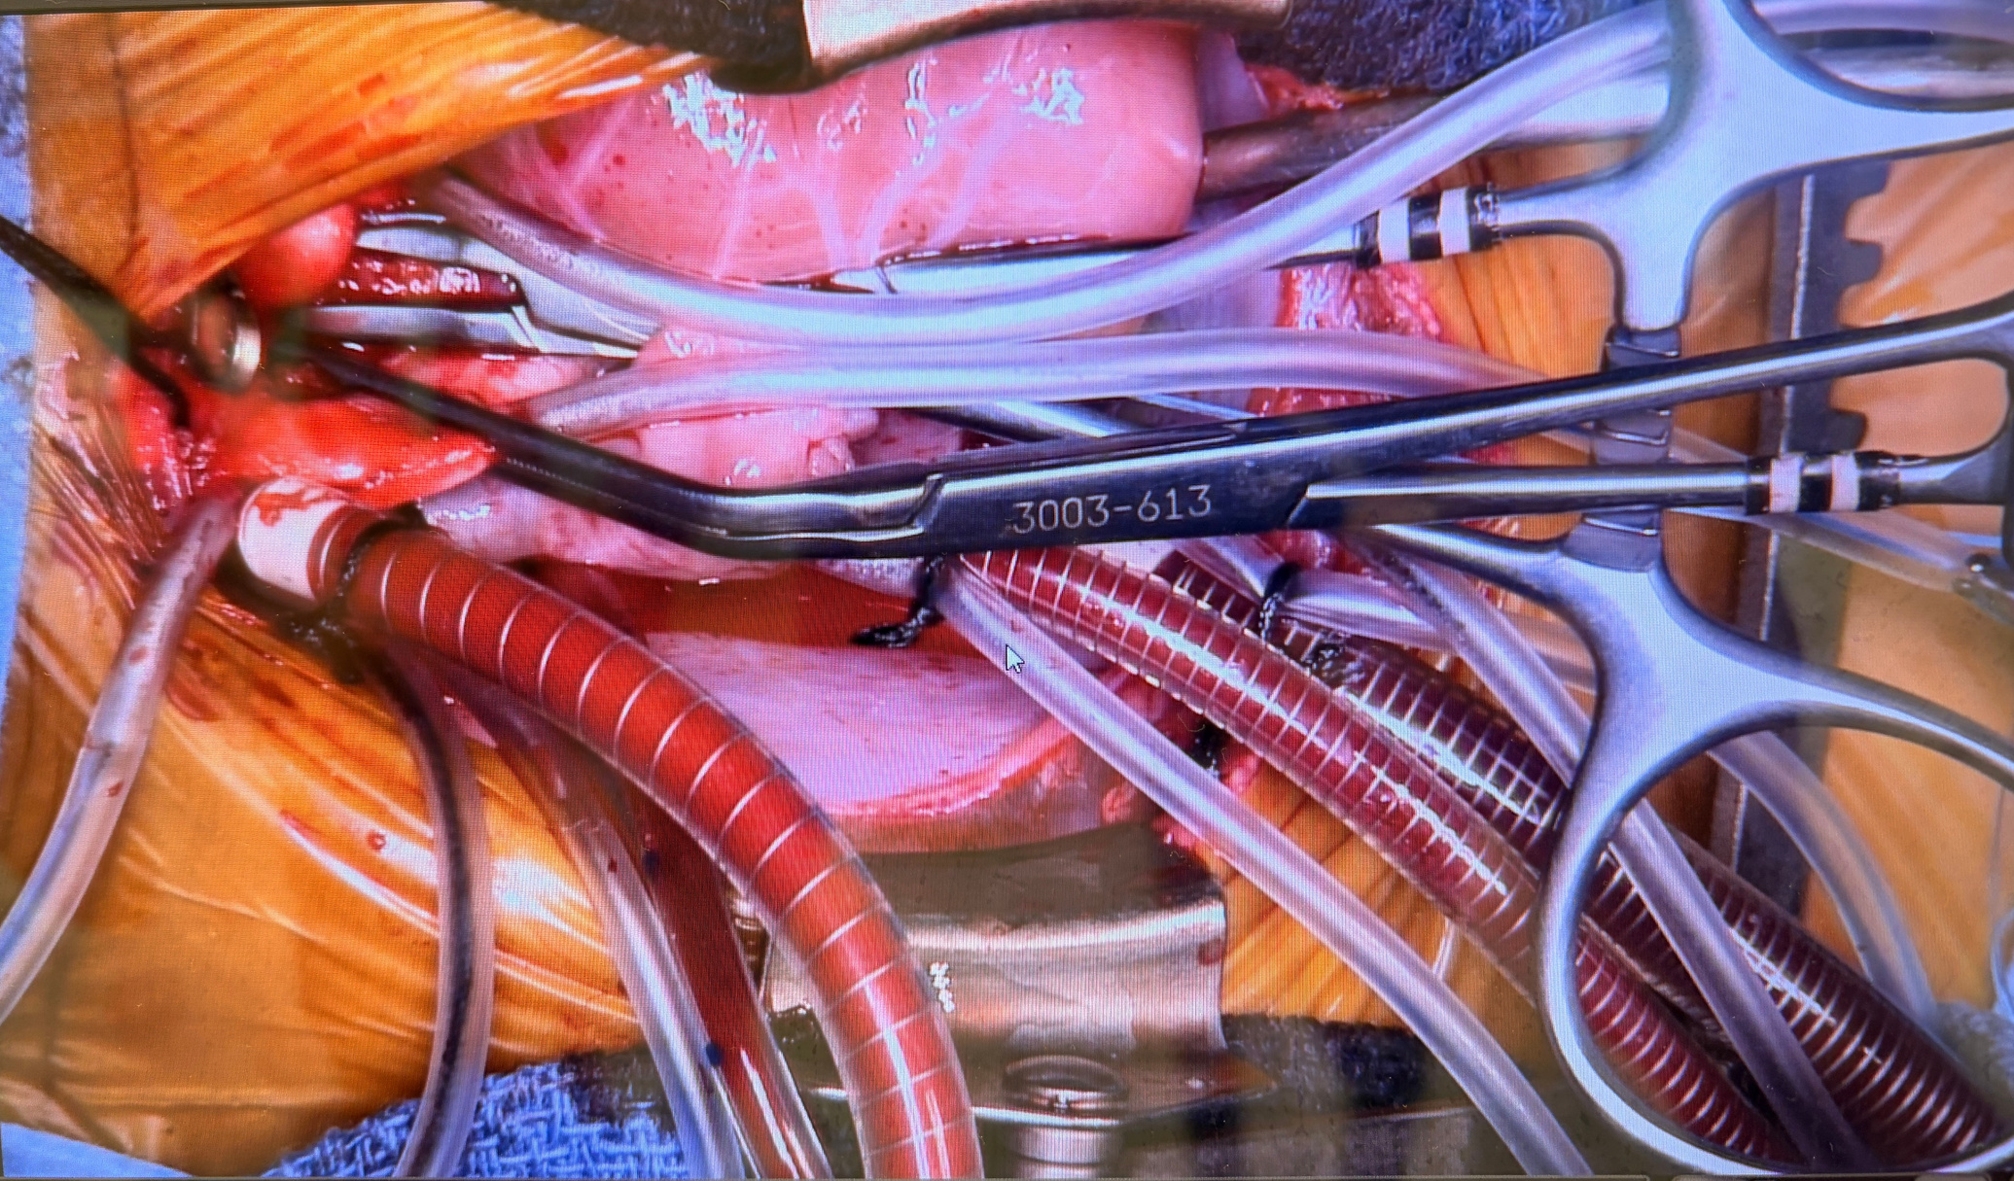
Cannulation
  8Fr curved aortic cannula for arterial support
  6Fr one-piece DLP cannula for selective cerebral perfusion
  12Fr straight for SVC and 12Fr AMT for IVC venous cannulation
  The circuit was designed to provide adequate flow in a 2.4 kg neonate while minimizing resistance and trauma
  Direct selective cerebral perfusion techniques have been reported as safe even in low-birth-weight neonates

Slide 8
Temperature Management and DHCA
Alpha-stat management was used during cooling and arrest.
Deep hypothermia reduces metabolic demand and supports safe arrest time.
Rewarming was slow to avoid temperature gradients and instability.
Neonatal arch surgery has historically relied on deep hypothermia, though newer approaches also support moderate hypothermia with cerebral perfusion.
DHCA time: 9 minutes
Used only briefly for the arch transition
Kalfa et al. (2014) supports short DHCA as safe when kept well under prolonged arrest times
Cooling was gradual to 20°C
Cooling rate: 1–2°C per minute

Slide 9
SCP and Cardioplegia
  SCP time: 31 minutes
  Flow target: 50–100 mL/kg/min
  Radial MAP target: around 50 mmHg
  NIRS monitored continuously
  SCP is reported as safe and reproducible in neonatal arch repair, including cases with VSD closure (Luciani et al., 2019)
  Del Nido cardioplegia used
  Dose: 60 mL total, or 25 mL/kg
  Cross-clamp time: 92 minutes
  Del Nido is associated with less interruption, lower cardioplegia volume and similar outcomes to conventional cardioplegia in infants and neonates (Panigrahi et al., 2018)

Slide 10
Ultrafiltration and metabolic management
  Hemoconcentration: 80 mL
  Zero-balance ultrafiltration: 800 mL
  Helped with fluid balance, blood conservation, and metabolic clearance
  Ultrafiltration in infants has been associated with improved physiologic outcomes (Zhou et al., 2013)
  Lactate improved from 4.4 mmol/L to 3.0 mmol/L
  ZBUF helped clear metabolic waste, this was important in a 2.4 kg neonate with limited reserve (Zhou et al., 2013)

Slide 11
Topic | Current literature | Our method
Cerebral protection | Neonatal arch repair literature shows that increasing DHCA duration worsens short-term recovery, while antegrade cerebral perfusion is the strategy associated with less recovery delay and lower neurologic risk (Algra et al., 2012). | 9 minutes DHCA + 31 minutes selective cerebral perfusion to keep arrest brief and maintain continuous cerebral protection.
Overall arch strategy | Modern neonatal arch perfusion has shifted from DHCA alone toward selective antegrade cerebral perfusion, with newer trends adding lower body perfusion for broader organ protection (Arcieri, Federici and Giordano, 2020). | Selective cerebral perfusion was used after brief DHCA to protect the brain during arch reconstruction without prolonged circulatory arrest.
Cardioplegia | Del Nido cardioplegia in infants and neonates provides similar myocardial protection to conventional multidose cardioplegia, with less interruption and lower cardioplegia volume (Pourmoghadam et al., 2017). | Del Nido single-dose cardioplegia, 25 mL/kg, used to cover a 92-minute cross-clamp with no need for routine redosing.
Oxygenator choice | Neonatal perfusion literature emphasizes that prime volume is a major cause of hemodilution; the Capiox FX05 has a 43 mL prime and 0.1–1.5 L/min flow range (Deptula et al., 2009). | CAPIOX FX05 chosen specifically to reduce hemodilution in a 2.4 kg neonate and keep the prime-to-blood ratio low.
Ultrafiltration | Pediatric cardiac surgery reviews show that ultrafiltration can improve physiologic outcomes, reduce fluid overload, and ZBUF can reduce inflammatory cytokines and improve pulmonary function (Bierer et al., 2019). | Hemoconcentration plus ZBUF used for blood conservation and metabolic cleanup, with lactate improving from 4.4 to 3.0 mmol/L.
Low-weight neonates | Neonates and infants ≤2.5 kg are higher-risk, and low-weight arch patients have greater mortality and reintervention risk in published series (Karamlou et al., 2009). | Case managed with low-prime circuit, careful cannulation, and tightly controlled flows because the patient weighed 2.4 kg.
Perfusion trend | Current trends in neonatal arch surgery support combining cerebral perfusion with broader organ protection rather than relying only on deep circulatory arrest (Luciani et al., 2019). | Our method followed that trend by combining brief DHCA, SCP, cardioplegia, and ultrafiltration in one integrated perfusion plan.

Slide 12
References
Algra, S.O., Verena N.N. Kornmann, Ingeborg, Antonius N.J. Schouten, Nicolaas J.G. Jansen and Haas, F. (2012). Increasing duration of circulatory arrest, but not antegrade cerebral perfusion, prolongs postoperative recovery after neonatal cardiac surgery. Journal of thoracic and cardiovascular surgery/The Journal of thoracic and cardiovascular surgery/The journal of thoracic and cardiovascular surgery, 143(2), pp.375–382. doi:https://doi.org/10.1016/j.jtcvs.2011.08.006.
Arcieri, L., Federici, D. and Giordano, R. (2020). Current trends in perfusion strategies for neonates undergoing aortic arch repair: the rough path to the perfect idea. Journal of Thoracic Disease, 12(6), pp.3436–3438. doi:https://doi.org/10.21037/jtd.2020.01.60.
Baker, R.A., Bronson, S.L., Dickinson, T.A., Fitzgerald, D., Likosky, D.S., Mellas, N.B. and Shann, K.G. (2013). Report from AmSECT’s International Consortium for Evidence-Based Perfusion: American Society of ExtraCorporeal Technology Standards and Guidelines for Perfusion Practice: 2013. The journal of extra-corporeal technology, 45(3), pp.156–166. doi:https://doi.org/10.1051/ject/201345156.
Bierer, J., Stanzel, R., Henderson, M., Sett, S. and Horne, D. (2019). Ultrafiltration in Pediatric Cardiac Surgery Review. World Journal for Pediatric and Congenital Heart Surgery, 10(6), pp.778–788. doi:https://doi.org/10.1177/2150135119870176.
Deptula, J., Valleley, M., Glogowski, K., Detwiler, J., Hammel, J. and Duncan, K. (2009). Clinical Evaluation of the Terumo Capiox ® FX05 Hollow Fiber Oxygenator with Integrated Arterial Line Filter. Journal of ExtraCorporeal Technology, 41(4), pp.220–225. doi:https://doi.org/10.1051/ject/200941220.
Kalfa, D., Krishnamurthy, G., Duchon, J., Najjar, M., Levasseur, S., Chai, P.J., Chen, J., Quaegebeur, J.M. and Bacha, E.A. (2014). Outcomes of cardiac surgery in patients weighing <2.5 kg: Affect of patient-dependent and -independent variables. The Journal of Thoracic and Cardiovascular Surgery, 148(6), pp.2499-2506.e1. doi:https://doi.org/10.1016/j.jtcvs.2014.07.031.
Karamlou, T., Bernasconi, A., Jaeggi, E., Alhabshan, F., Williams, W.G., Van Arsdell, G.S., Coles, J.G. and Caldarone, C.A. (2009). Factors associated with arch reintervention and growth of the aortic arch after coarctation repair in neonates weighing less than 2.5 kg. The Journal of Thoracic and Cardiovascular Surgery, 137(5), pp.1163–1167. doi:https://doi.org/10.1016/j.jtcvs.2008.07.065.
Luciani, G.B., Hoxha, S., Angeli, E., Petridis, F., Careddu, L., Rungatscher, A., Caputo, M. and Gargiulo, G. (2019). Selective versus standard cerebro‐myocardial perfusion in neonates undergoing aortic arch repair: A multi‐center study. Artificial Organs, 43(8), pp.728–735. doi:https://doi.org/10.1111/aor.13430.
Newland, R.F. and Baker, R.A. (2017). Low Oxygen Delivery as a Predictor of Acute Kidney Injury during Cardiopulmonary Bypass. The journal of extra-corporeal technology, 49(4), pp.224–230. doi:https://doi.org/10.1051/ject/201749224.
Panigrahi, D., Roychowdhury, S., Guhabiswas, R., Rupert, E., Das, M. and Narayan, P. (2018). Myocardial protection following del Nido cardioplegia in pediatric cardiac surgery. Asian Cardiovascular & Thoracic Annals, [online] 26(4), pp.267–272. doi:https://doi.org/10.1177/0218492318773589.
Pourmoghadam, K.K., Ruzmetov, M., O’Brien, M.C., Piggott, K.D., Plancher, G., Narasimhulu, S.S., Benjamin, T. and Decampli, W.M. (2017). Comparing del Nido and Conventional Cardioplegia in Infants and Neonates in Congenital Heart Surgery. The Annals of Thoracic Surgery, [online] 103(5), pp.1550–1556. doi:https://doi.org/10.1016/j.athoracsur.2016.10.070.
Zhou, G., Feng, Z., Xiong, H., Duan, W. and Jin, Z. (2013). A Combined Ultrafiltration Strategy During Pediatric Cardiac Surgery: A Prospective, Randomized, Controlled Study With Clinical Outcomes. Journal of Cardiothoracic and Vascular Anesthesia, 27(5), pp.897–902. doi:https://doi.org/10.1053/j.jvca.2013.01.006.

Slide 13

THANK YOU
FOR YOUR ATTENTION

